Slide 1


Submitted By: Lav Varshney(181500350) Shruti Sharma(181500692) Mukund Agrawal(181500401)
Text Extraction From Image
Submitted To:
Mr. Mandeep Singh
(Technical Trainer)

Slide 2
Introduction
Text Extraction is a process by which we convert Scanned page or image in which text content is available to ASCII character that a computer can recognize.
Today’s world is digital with the appearance of many devices that are used in image acquisition. Nowadays, it becomes easy to store huge number of images by using image processing techniques. Since the collection of images and databases is fast and is increasing day by day, there is a need for new image retrieval techniques that should be efficient and fast.

Slide 3
What is Text Extraction ??
Text Extraction is a process by which we convert Printed document/Scanned Page or Image in which text are available to ASCII Character that a Computer can Recognize.

Slide 4
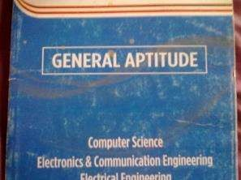
Goal Of Project
GENERAL APTITUDE
Computer Science Electronics & Communication Engineering

Slide 5











How Will We Archive That Goal ??
Pre
Segmentation
Recognition
processing

Slide 6



Pre-Processing

Slide 7




Pre-Processing
Gray Scale
Noise Removal
Thresholding

Slide 8

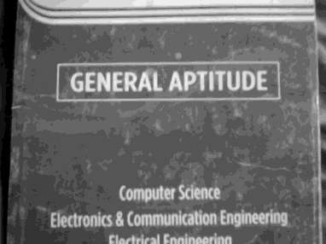
Gray Scale

Slide 9
Noise Removal
Noise Removal is used to Enhance the Image
For Enhancing We have used Median Filter
FilteredImage = Median Filter(Origional Image, FilterSize)
We have used FilterSize [5,5]

Slide 10
Thresholding
Edge Detection
Dilate Image
Detect Text Area Using Histrogram
Personal Thresholding to Text Area

Slide 11


Segmentation

Slide 12





Segmentation
Line
Word
Character
Segmentation
Segmentation
Segmentation

Slide 13
TEXT SEGMENTATION
From above Image, Image are segment in to Different Lines, Below an example of Only For one Line.

Slide 14











Segmentation
Find all the word than convert text area in one image
Character are separate from the
word

Slide 15


Recognition

Slide 16




Recognization
Feature Extraction
Classifier
Text Document

Slide 17
Recognization
Feature Extraction
Binary Code Method
Chain Code Method
PCA (Principle Component Analysis)
LDA (Linear Discriminative Image)
Classifier
Artificial Neural Network
Support Vector Machine

Slide 18
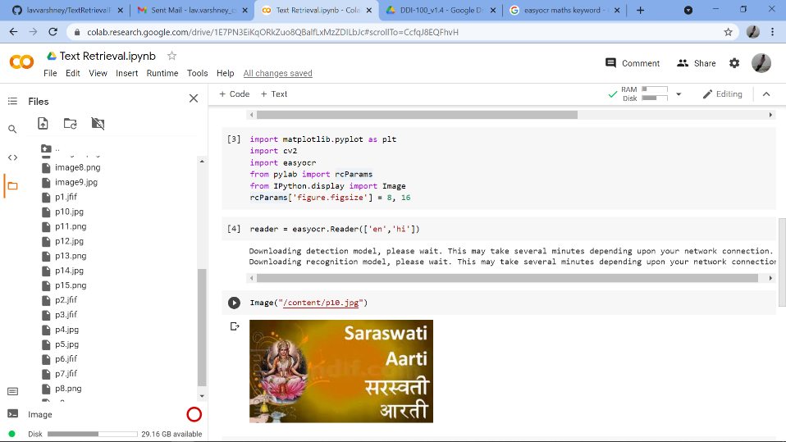
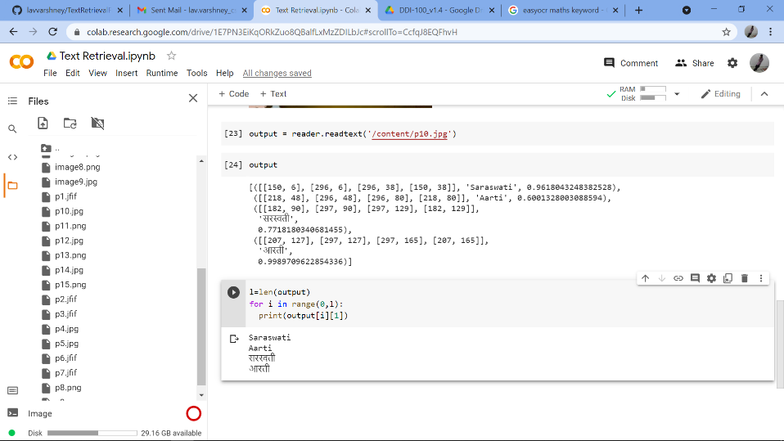
Working Project Outputs

Slide 19
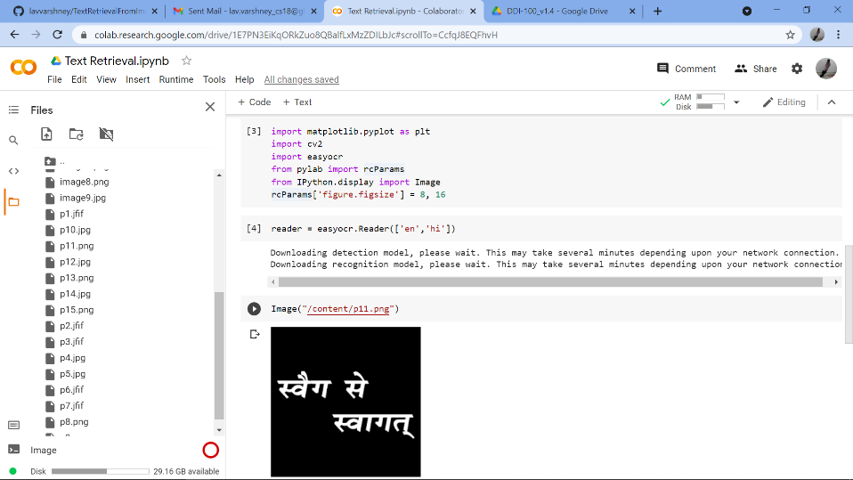
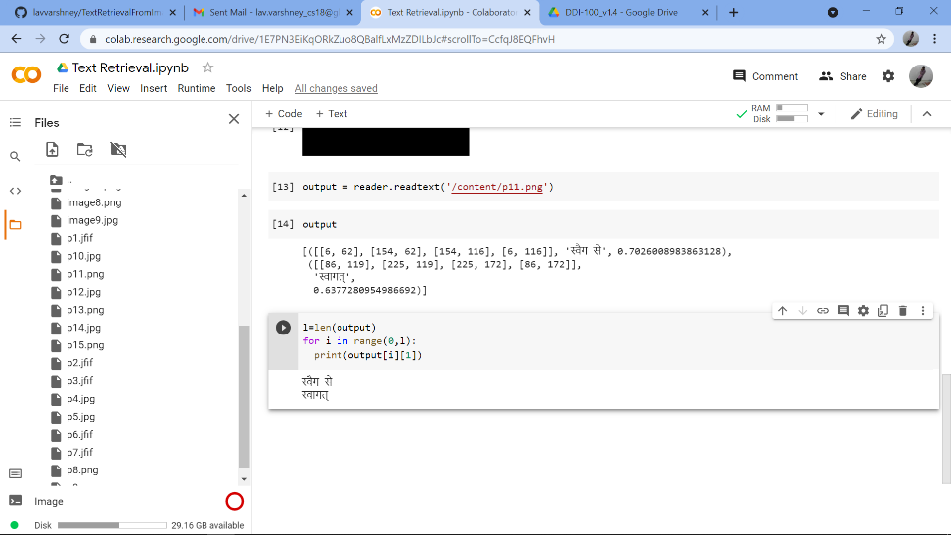
Working Project Outputs(Cont…)

Slide 20
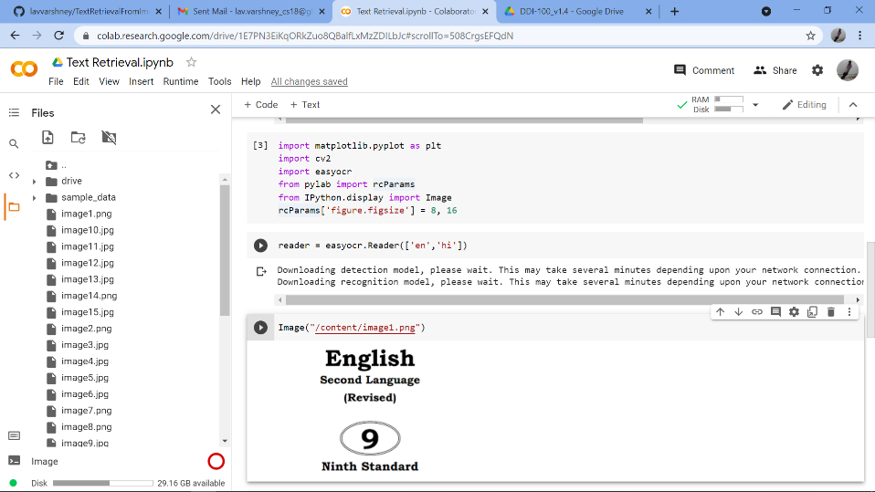
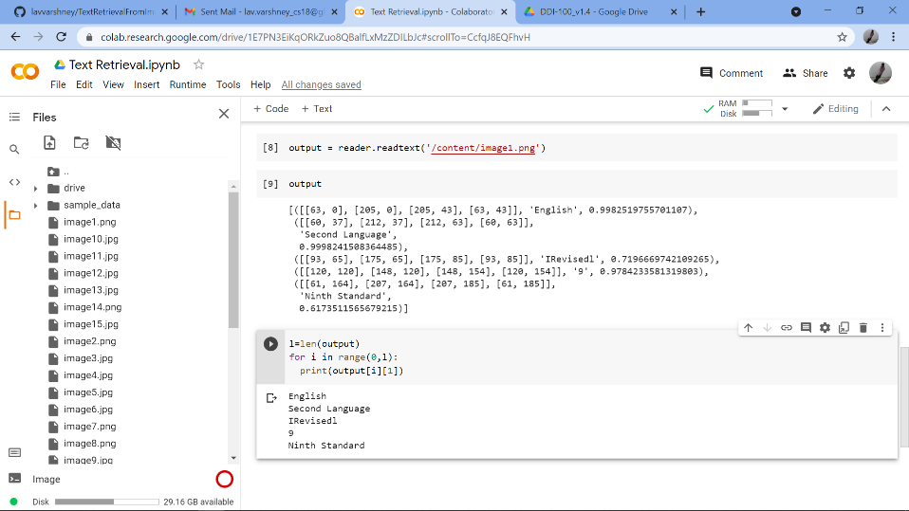
Working Project Outputs(Cont…)

Slide 21
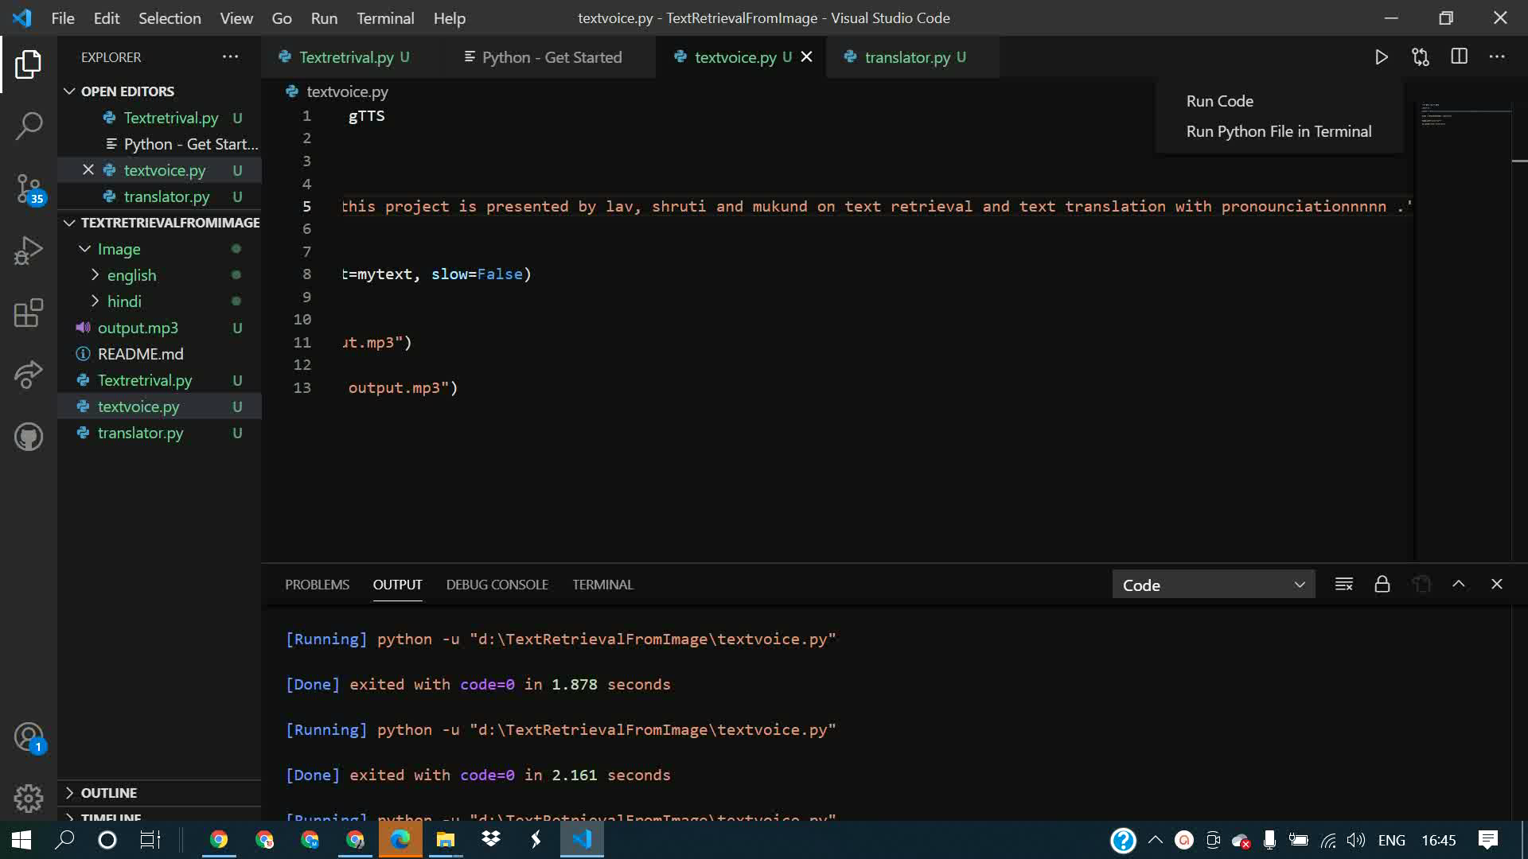

Slide 22
Applications
Banking (To read Credit Card)
Libraries (To convert Scanned Page to Image)
Govt. Sector (Form Processing)
Used in Car Number Plate Recognition System
Undesirable Text removal from images.

Slide 23


Thank You

